Slide 1
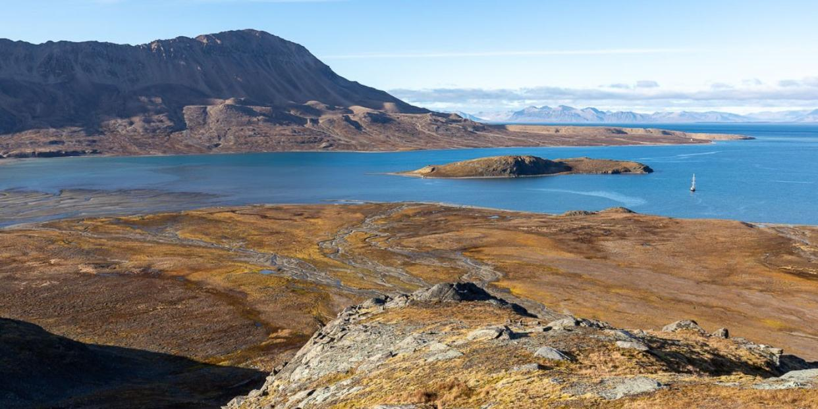

AS KULSPIDS · SØRE FAGERFJORD · SVALBARD
The Arctic Preservation Initiative - A Rare Private Legacy in Svalbard
The opportunity may be straightforward: acquire AS Kulspids and keep Søre Fagerfjord intact and protected. Alternatively, the property may anchor a wider Arctic conservation initiative with an independent foundation, selected investors, philanthropic partners and scientific and environmental organisations. A separate platform may support nature-based solutions, carbon and biodiversity projects with measurable impact and, where appropriate, sustainable financial returns. Philanthropic funding and future proceeds may support Arctic conservation, research and climate initiatives.

Slide 2
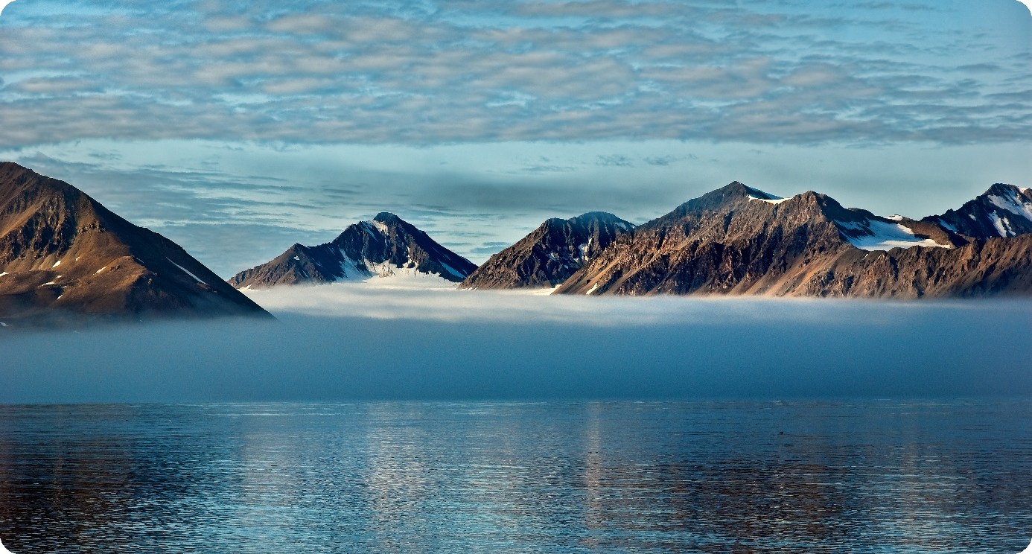
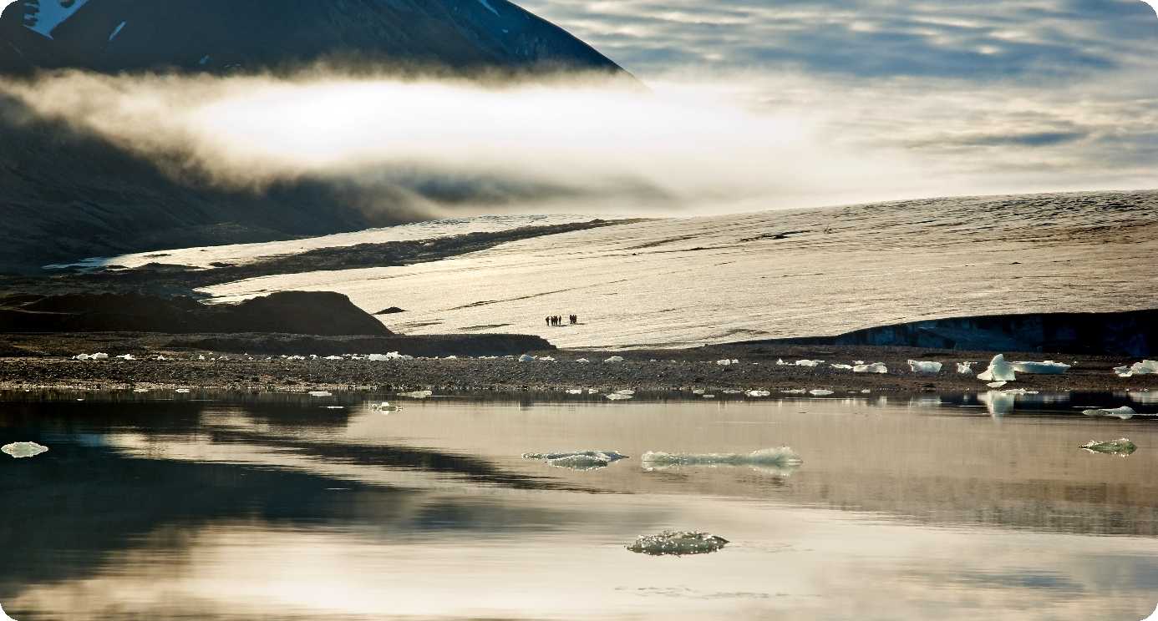
A High Arctic Legacy
INTRODUCING
14,830
acres / approx. 60 km²
at Søre Fagerfjord
— the size of Manhattan.
Set within a fjord in south-west Spitsbergen, the pristine, untouched yet fragile land includes 5 km of shoreline, the Reinholmen Island, a lagoon, mountains, glaciers, a river valley, flatland and wildlife habitats.
5 km of shoreline
Reinholmen Island & lagoon
Glaciers · river valley · wildlife
The Arctic Preservation Initiative
2

Slide 3
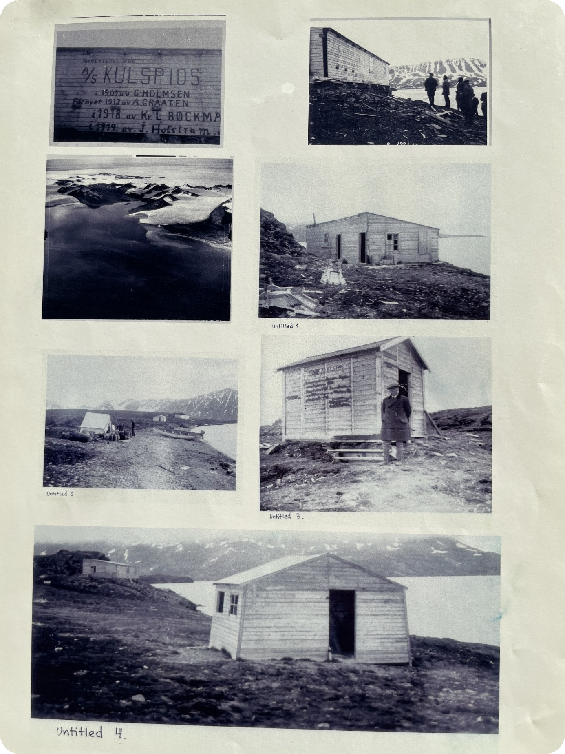




Sør-Spitsbergen National Park
The land is part of Sør-Spitsbergen National Park, mandated to protect:
An area with magnificent landscapes featuring distinctive sharp, alpine mountain formations, coastal plains and glaciers.
Several large and small breeding sites for seabirds known as bird cliffs, and breeding and wintering areas for ducks and eiders.
Important habitats for polar bears, reindeer and ptarmigans.
Important cultural heritage sites and cultural environments from the whaling era, winter trapping, mining, tourism, research and World War II.
Historical pictures from the Recherche Expedition era
Our land was explored and named during the first Arctic scientific expedition in history — the Recherche Expedition.
The Arctic Preservation Initiative
3

Slide 4
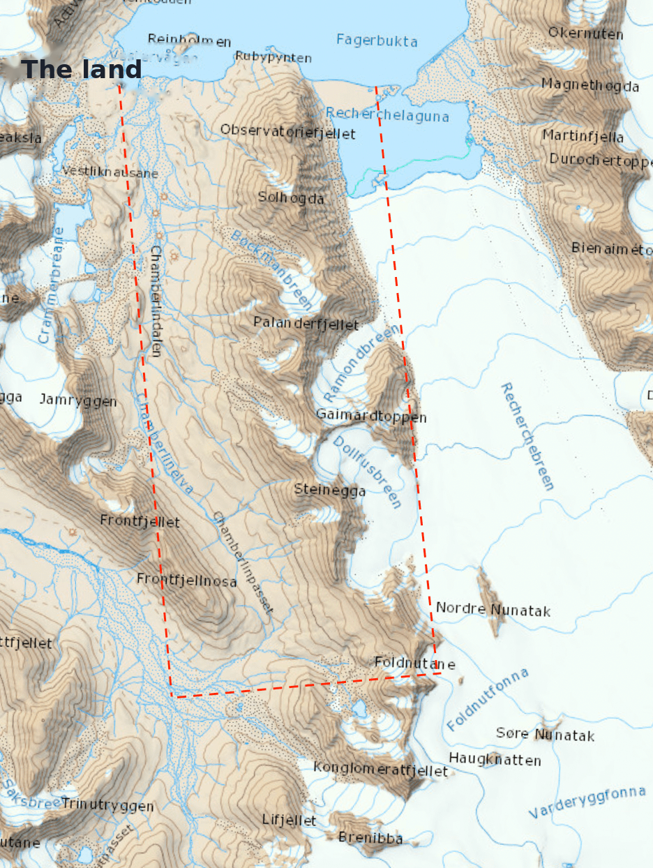
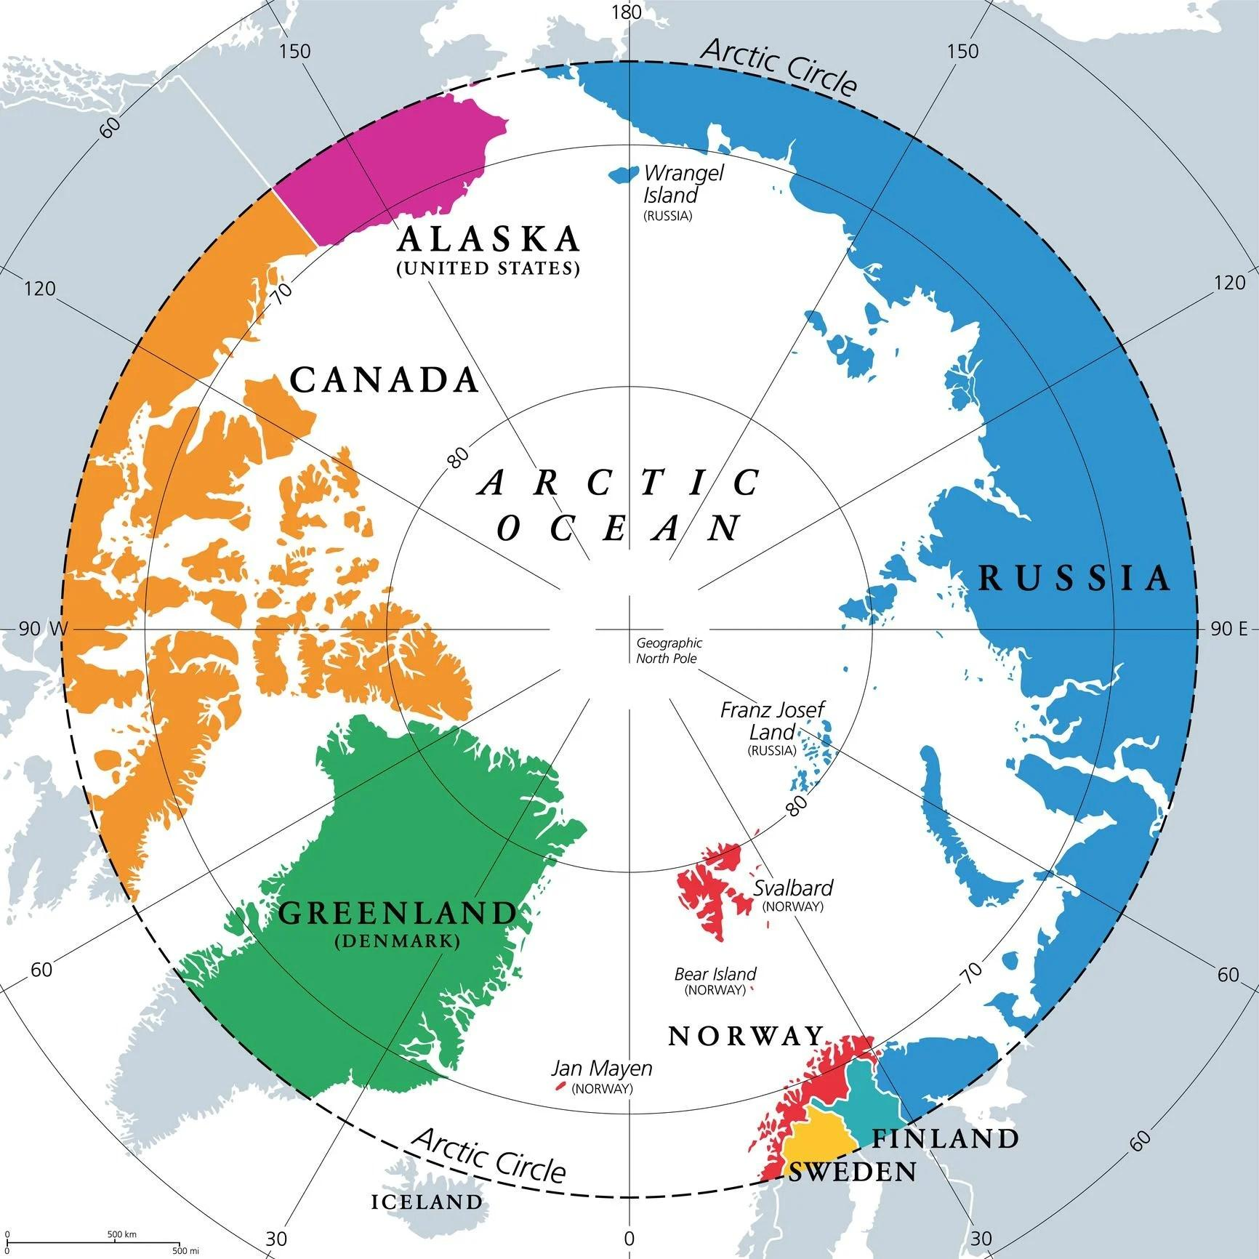
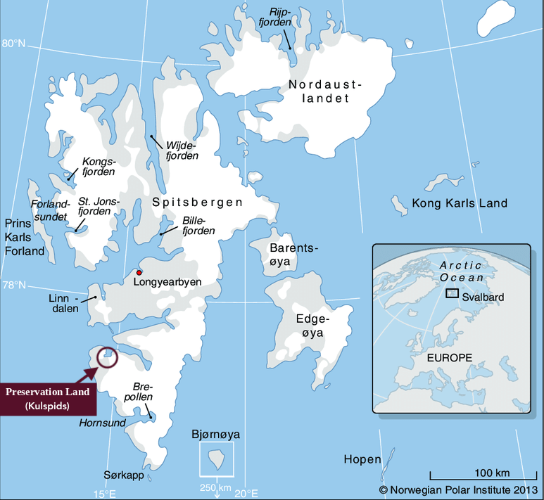

The Location of the Land
Søre Fagerfjord — satellite view
Location relative to Longyearbyen
The land at western Svalbard
The Arctic Preservation Initiative
4

Slide 5
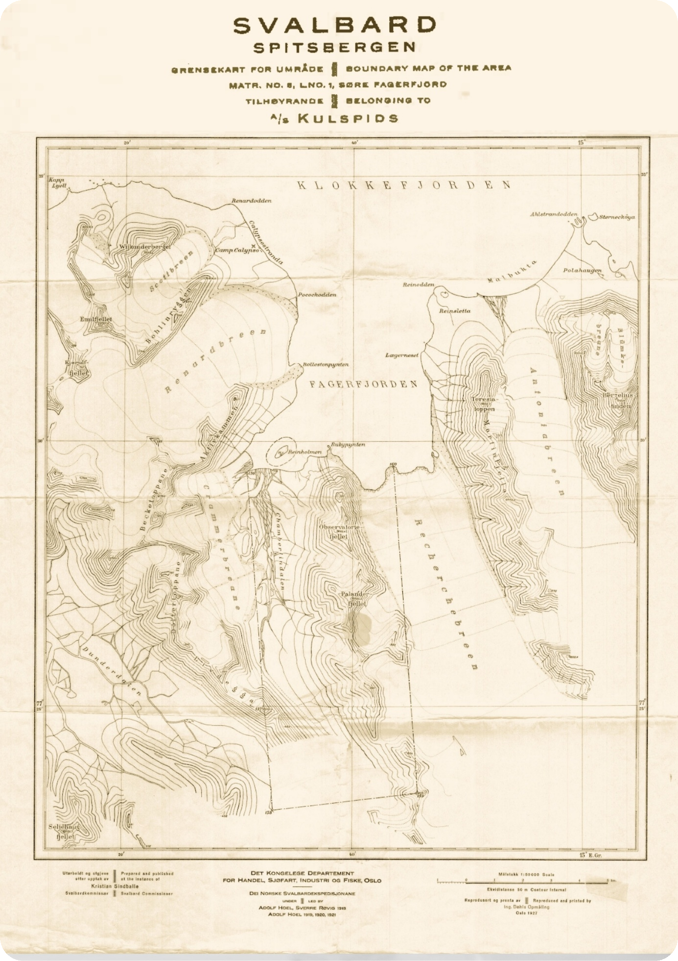
A Century-Old Ownership Platform
Aktieselskabet Kulspids is a privately owned Norwegian limited company incorporated on 26th October 1910. The single purpose company holds the exclusive ownership to the Treaty-property Søre Fagerfjord at Wedel Jarlsberg Land in Western Svalbard, recognised according to the Svalbard Treaty.
This is the only privately owned land at Svalbard, located around 3 hours by boat from Longyearbyen. All other land on Svalbard except for «Søre Fagerfjord» are owned by Norway and Russia. Consequently, this represents the only opportunity whatsoever to acquire land at Svalbard. Considering the geopolitical and strategical aspects, the climate changes and the increasing interest of the arctic areas in general, the property represents a unique opportunity.
1910
3 hours
Sole Holding
Incorporated 26th October
By boat from Longyearbyen
Privately owned at Svalbard
Property boundary — Søre Fagerfjord
The Arctic Preservation Initiative
5

Slide 6
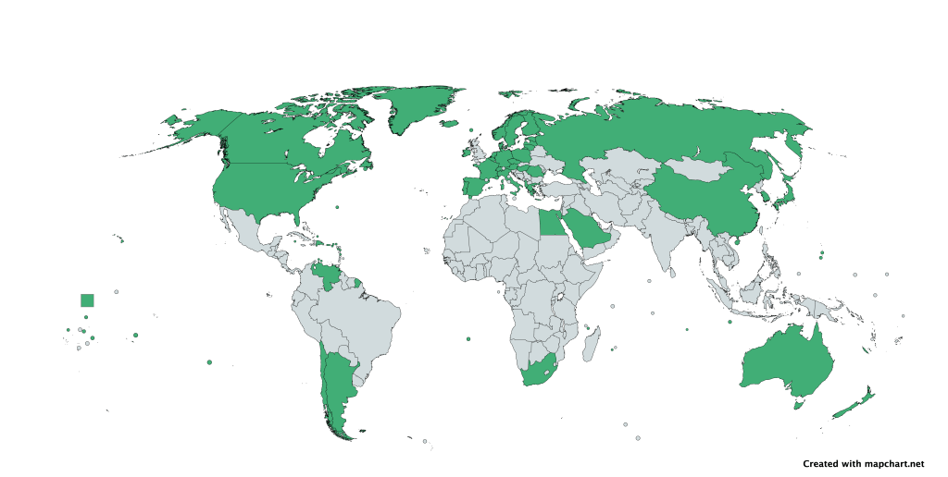



The Svalbard Treaty
Ownership of the Company (shares) may be transferred to citizens and organisations lawfully constituted and having their administrations in countries that have ratified the Svalbard Treaty and not representing a security threat to the region.
The Spitsbergen Treaty allows for the owners of landed property always be at liberty to establish and use for their own purpose wireless telegraphy installations, which will be free to communicate on private business with fixed or moving wireless stations. Svalbard creates unique conditions for satellite communication and scientific research.
Spitsbergen treaty countries: Afghanistan, Albania, Argentina, Australia, Austria, Belgium, Bulgaria, Canada, Chile, China, Czech Republic, Denmark, Dominican Republic, Egypt, Estonia, Finland, France, Germany, Greece, Hungary, Iceland, India, Ireland, Italy, Japan, Latvia, Lithuania, Monaco, Netherlands, New Zealand, North Korea, Norway, Poland, Portugal, Romania, Russia, Saudi Arabia, Serbia, Slovakia, South Africa, South Korea, Spain, Sweden, Switzerland, Türkiye, United Arab Emirates, United Kingdom, United States, Venezuela — and overseas territories under the signatory countries.
6

Slide 7
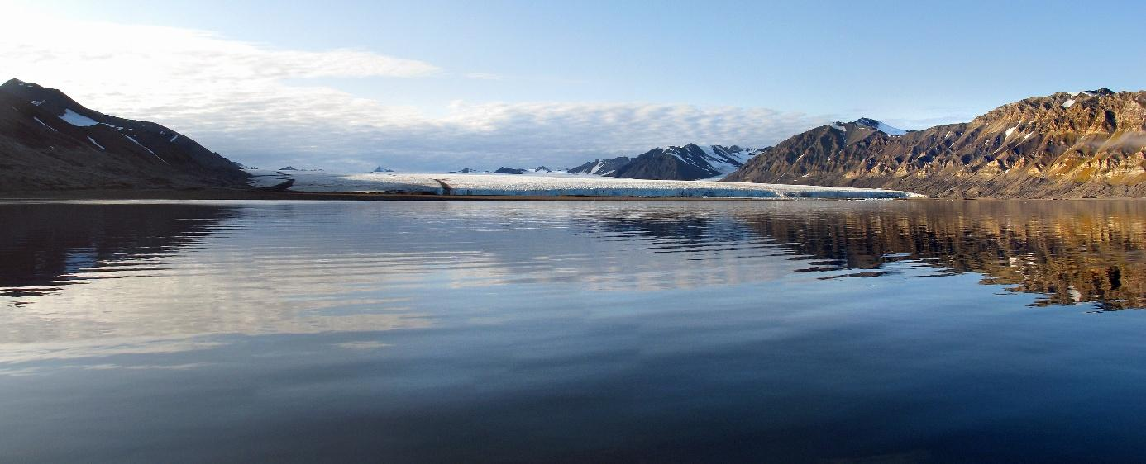

Potential Stewards and Partners
Philanthropic and impact platforms – partners for separately governed Arctic programmes.
Sustainable / Environmental Funds and Organisations – gaining returns from carbon rights and biodiversity values while preserving and managing a unique piece of land that will probably increase in value over time.
NGO´s & Conservation Partners – engaging in environmental preservation and developments and a possibility to enter litigations as a landowner and increase its impacts, potential long-term stewards where mandate, governance and legal structure fit.
Investment Companies and other buyers – acquiring a rare and significant asset with long-term value, whether for conservation, sustainable use, strategic positioning or legacy purpose.
Public and expert partners – authorities, conservation organisations and advisers supporting credible stewardship.
7

Slide 8





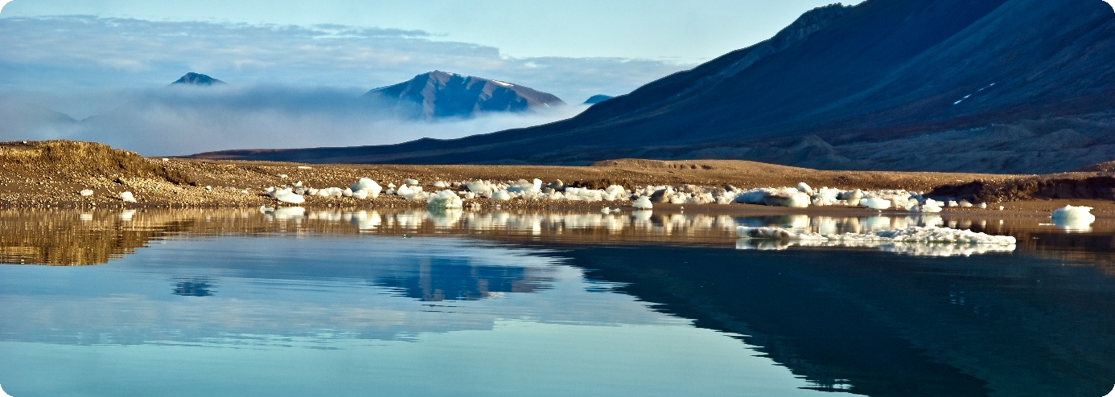


Strategic Opportunity
By acquiring an ownership interest in the Company, the Investor may obtain the opportunity, subject to future agreements and applicable laws, to gradually assume full or partial responsibility for the Arctic Preservation Initiative and its long-term development for the environment, in compliance with the Norwegian Security Act and the royal decree of 25 June 2024 according to the same.
The wider initiative may include:
Keep Søre Fagerfjord intact and protected as the cornerstone of the Initiative.
Engage selected co-investors, philanthropic partners, family offices and foundations.
Build partnerships with scientific institutions and environmental organisations.
This includes the opportunity to establish, manage or support an independent foundation dedicated to protecting the Arctic environment and other environmentally significant regions around the world.
Invest separately in qualifying nature-based solutions, carbon projects and biodiversity initiatives.
Explore tokenised investment in the wider platform, separate from ownership of AS Kulspids.
Support conservation, biodiversity protection and scientific research throughout the Arctic.
Seek measurable environmental impact and, where appropriate, sustainable financial returns.
Use philanthropic funding and a share of future proceeds to support Arctic climate initiatives.
The Arctic Preservation Initiative
8

Slide 9
Long-Term Stewardship
The Arctic Preservation Initiative is intended to become more than a commercial investment. It represents a platform where environmental conservation, sustainable finance and responsible ownership can coexist.
The Investor may therefore participate in building an internationally recognized environmental initiative capable of generating long-term value through innovative conservation Initiatives, carbon markets, strategic partnerships and philanthropic engagement.
9

Slide 10
Ownership First. Platform Later.
The core proposition remains simple, with a wider platform available if desired.
The opportunity may be straightforward: acquire AS Kulspids and keep Søre Fagerfjord intact and protected. Alternatively, the property may become the cornerstone of a wider Arctic conservation and natural capital initiative.
(a)
LONG-TERM OWNERSHIP
Acquire an ownership interest in AS Kulspids and preserve Søre Fagerfjord for future generations.
(b)
OPTIONAL WIDER PLATFORM
Develop an independent foundation alongside selected co-investors such as philanthropic partners, scientific institutions, environmental organisations etc.
The property remains protected. The wider platform may seek measurable environmental impact and, where appropriate, sustainable financial returns.
The Arctic Preservation Initiative
10

Slide 11
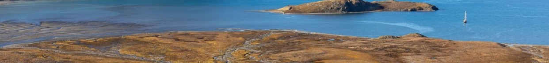

Contacts
MAIN CONTACT
SELLERS REPRESENTATIVE
LONDON CONTACT
Per Kyllingstad
Carl Petter Christensen
Shareholder and Chairman AS Kulspids
Jonathan Webb
Advokat / Attorney at law
E-mail: pk@acmholding.no
Mobile: +47 920 90 467
E-mail: capech@icloud.com
Mobile: +47 900 24 471
Partner — Floyd Zadkovich LLP, London
E-mail: jonathan.webb@floydzad.com
Mobile: +44 (0) 208 017 2517
Søre Fagerfjord · Svalbard
11

